Slide 1
Digital Portfolio
STUDENT NAME: GOPI R
REGISTER NO AND NMID:asunm1703222410124
DEPARTMENT:B.sc Computer Sicence
COLLEGE: Aksheyaa college of arts and science/ University of Madras

Slide 2
PROJECT TITLE
Simple and formal resume digital portfolio using frent end devlopment

Slide 3


AGENDA
Problem Statement
Project Overview
End Users
Tools and Technologies
Portfolio design and Layout
Features and Functionality
Results and Screenshots
Conclusion
Github Link
3/21/2024 Annual Review

Slide 4

PROBLEM STATEMENT
Traditional resumes are static documents (PDF/Word) that limit interactivity and creativity.Recruiters often find it difficult to quickly evaluate skills and projects from plain text-based resumes.Lack of a centralized, accessible, and visually appealing platform to showcase an individual’s skills, education, and achievements.Need for a simple, formal, and professional digital portfolio that is easy to navigate and highlights core competencies effectively using front-end development technologies.

Slide 5

PROJECT OVERVIEW
The project focuses on creating a simple and formal digital resume portfolio using front-end development technologies such as HTML, CSS, and JavaScript. Unlike traditional resumes, this portfolio provides an interactive and visually appealing platform to present an individual’s skills, education, projects, and achievements in a structured way. With a clean and responsive design, the portfolio ensures accessibility across devices like desktops, tablets, and mobiles. The main objective is to offer recruiters and employers an easy-to-navigate, professional platform that enhances visibility and increases career opportunities.

Slide 6

WHO ARE THE END USERS?
Job Seekers & Students – To showcase resumes, skills, and projects online.
Recruiters & Hiring Managers – To easily evaluate candidate profiles.
Freelancers & Professionals – To present work portfolios to clients and peers.

Slide 7

TOOLS AND TECHNIQUES
Nice — I made a single-file, professional HTML resume that includes a Problem Statement (aka objective/summary) section at the top, is responsive, print-friendly, and easy to edit. Copy–paste the code into a file named resume.html and open it in a browser.

Slide 8
POTFOLIO DESIGN AND LAYOUT
Homepage – Clean introduction with name, designation, and a short tagline.
About Section – Personal details, education, and career goals.
Projects Section – Showcase completed projects with descriptions and links.
Skills Section – Highlight technical and soft skills with simple visuals.
8

Slide 9
FEATURES AND FUNCTIONALITY
Responsive Design – Works smoothly on desktop, tablet, and mobile devices.
Interactive Navigation – Easy access to different sections like About, Skills, and Projects.
Project Showcase – Detailed display of projects with links and descriptions.
Skill Highlights – Visual representation of technical and soft skills.

Slide 10
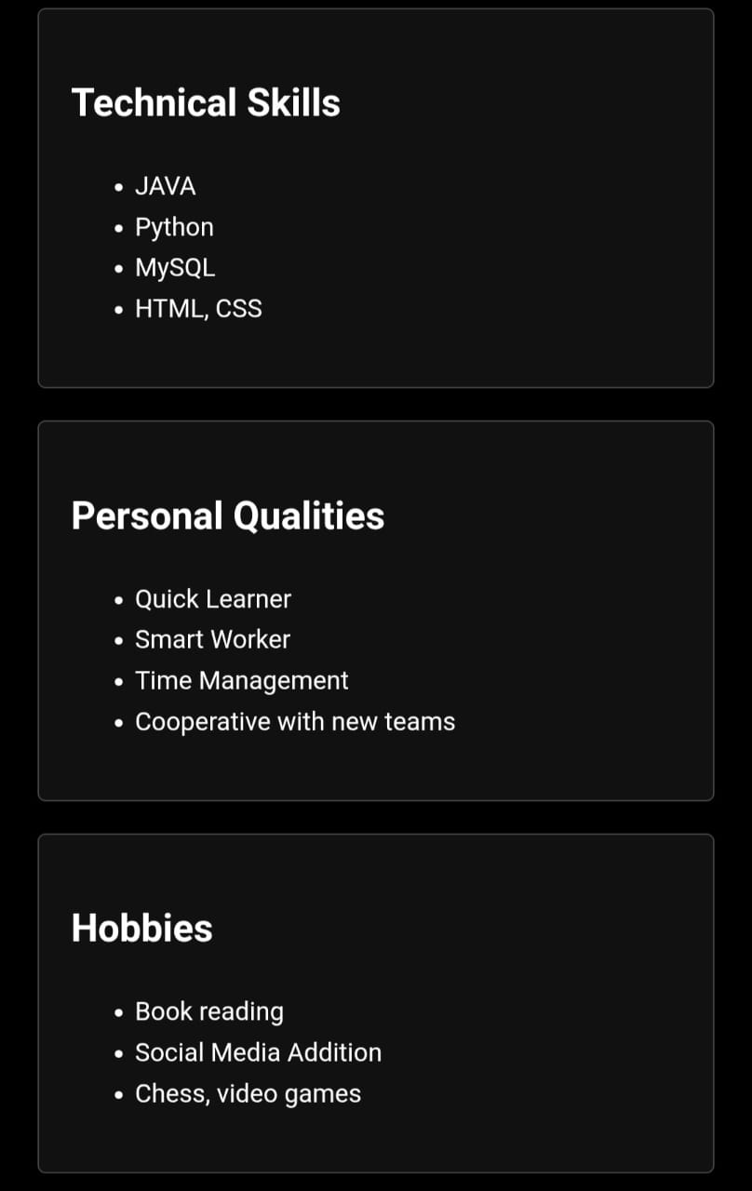
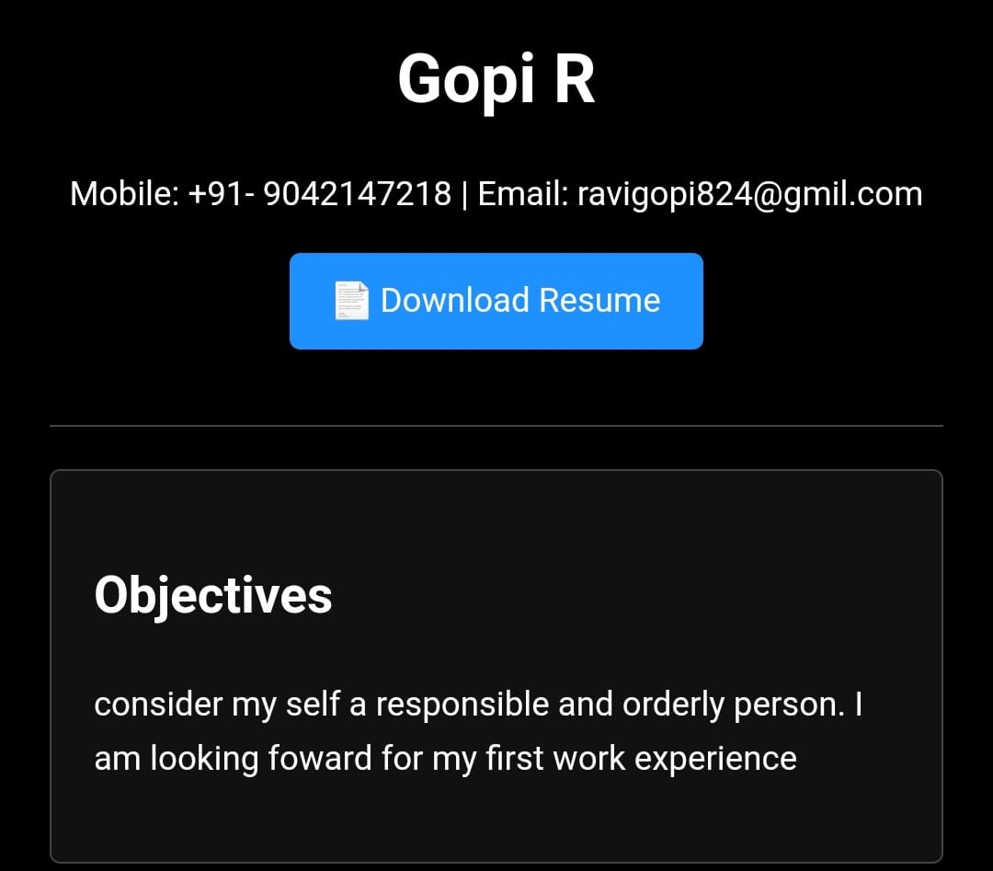

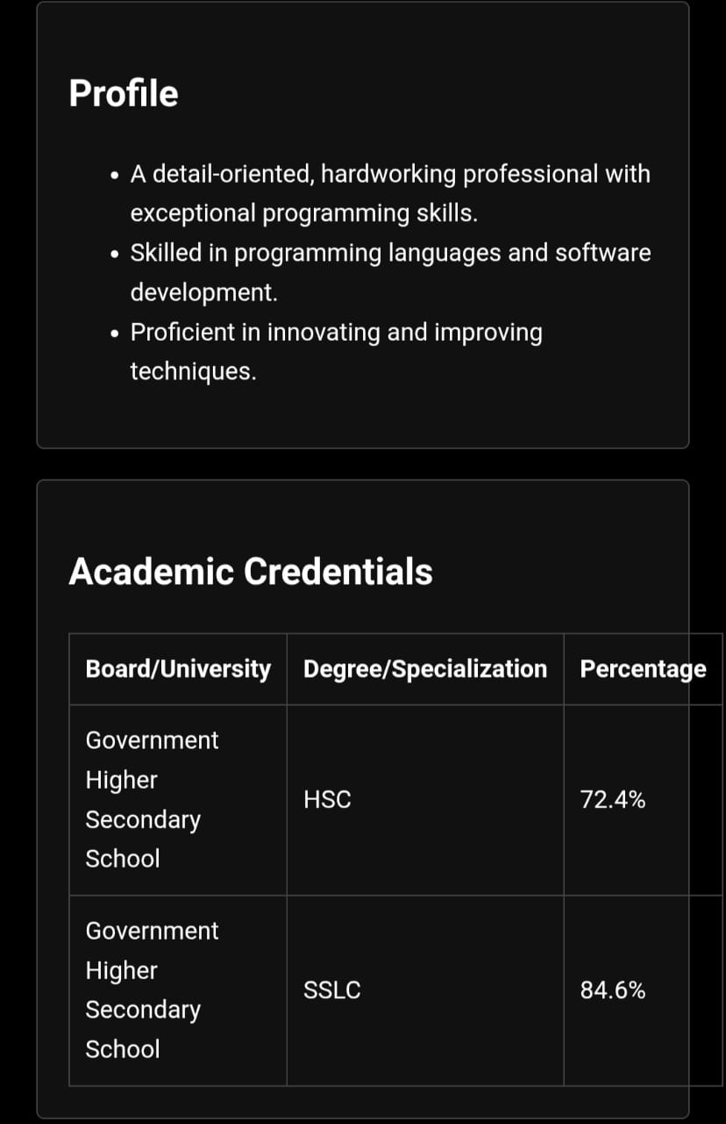
RESULTS AND SCREENSHOTS
3/21/2024 Annual Review
10

Slide 11
CONCLUSION
A digital resume portfolio provides a modern and professional way to showcase personal and academic achievements.
It is built using HTML, CSS, and JavaScript, ensuring a responsive and interactive design.
The portfolio helps job seekers, students, and professionals present their skills effectively.
Recruiters and clients gain easy access to evaluate profiles and projects online.
11

